Slide 1
MIDAS
Manuel Toledo : UML Engineer
Gabriel Alfonso : Quality Analyst
Edward Gil : Business Analyst

Slide 2
Problem Definition
Many niche apps used to track user finances
Users likely have multiple bank accounts open
Tedious to track finances through multiple applications, so why not have an all-in-one finance app?

Slide 3
Alternate Solutions
Alternatives differ in the platforms that are supported
Alternative 1: Web application and Android 5.0 application
Alternative 2: Web, Android 5.0, and iOS 8 applications
Alternative 3: Web, Android 5.0, iOS 8, and Windows 8.1 Desktop applications

Slide 4
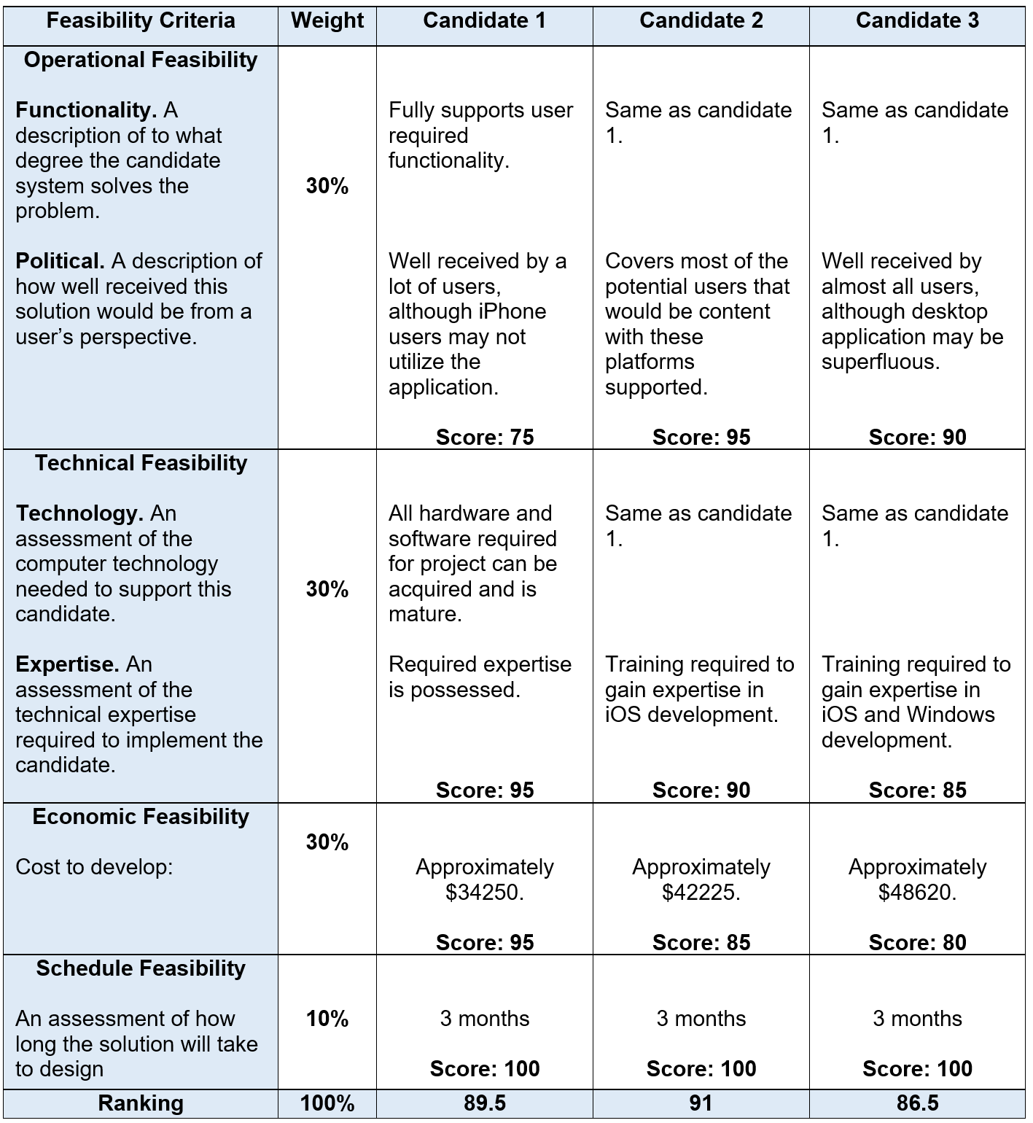
Feasibility Matrix
Recommendation: Candidate 2
Costs more, but covers most of the mobile users
Desktop application likely not as utilized, and costs more

Slide 5
Project Personnel Organization
Manuel Toledo:
Team Leader, UML Engineer
Edward Gil:
Minute Taker, Business Analyst
Gabriel Alfonso:
Time Keeper, Quality Analyst.

Slide 6
Hardware and Software Requirements
Hardware
Computer for Project Planning and UML Design
Software
Star UML
MS Project
React
Support on Chrome and Firefox
Mobile support for IOS and Android

Slide 7
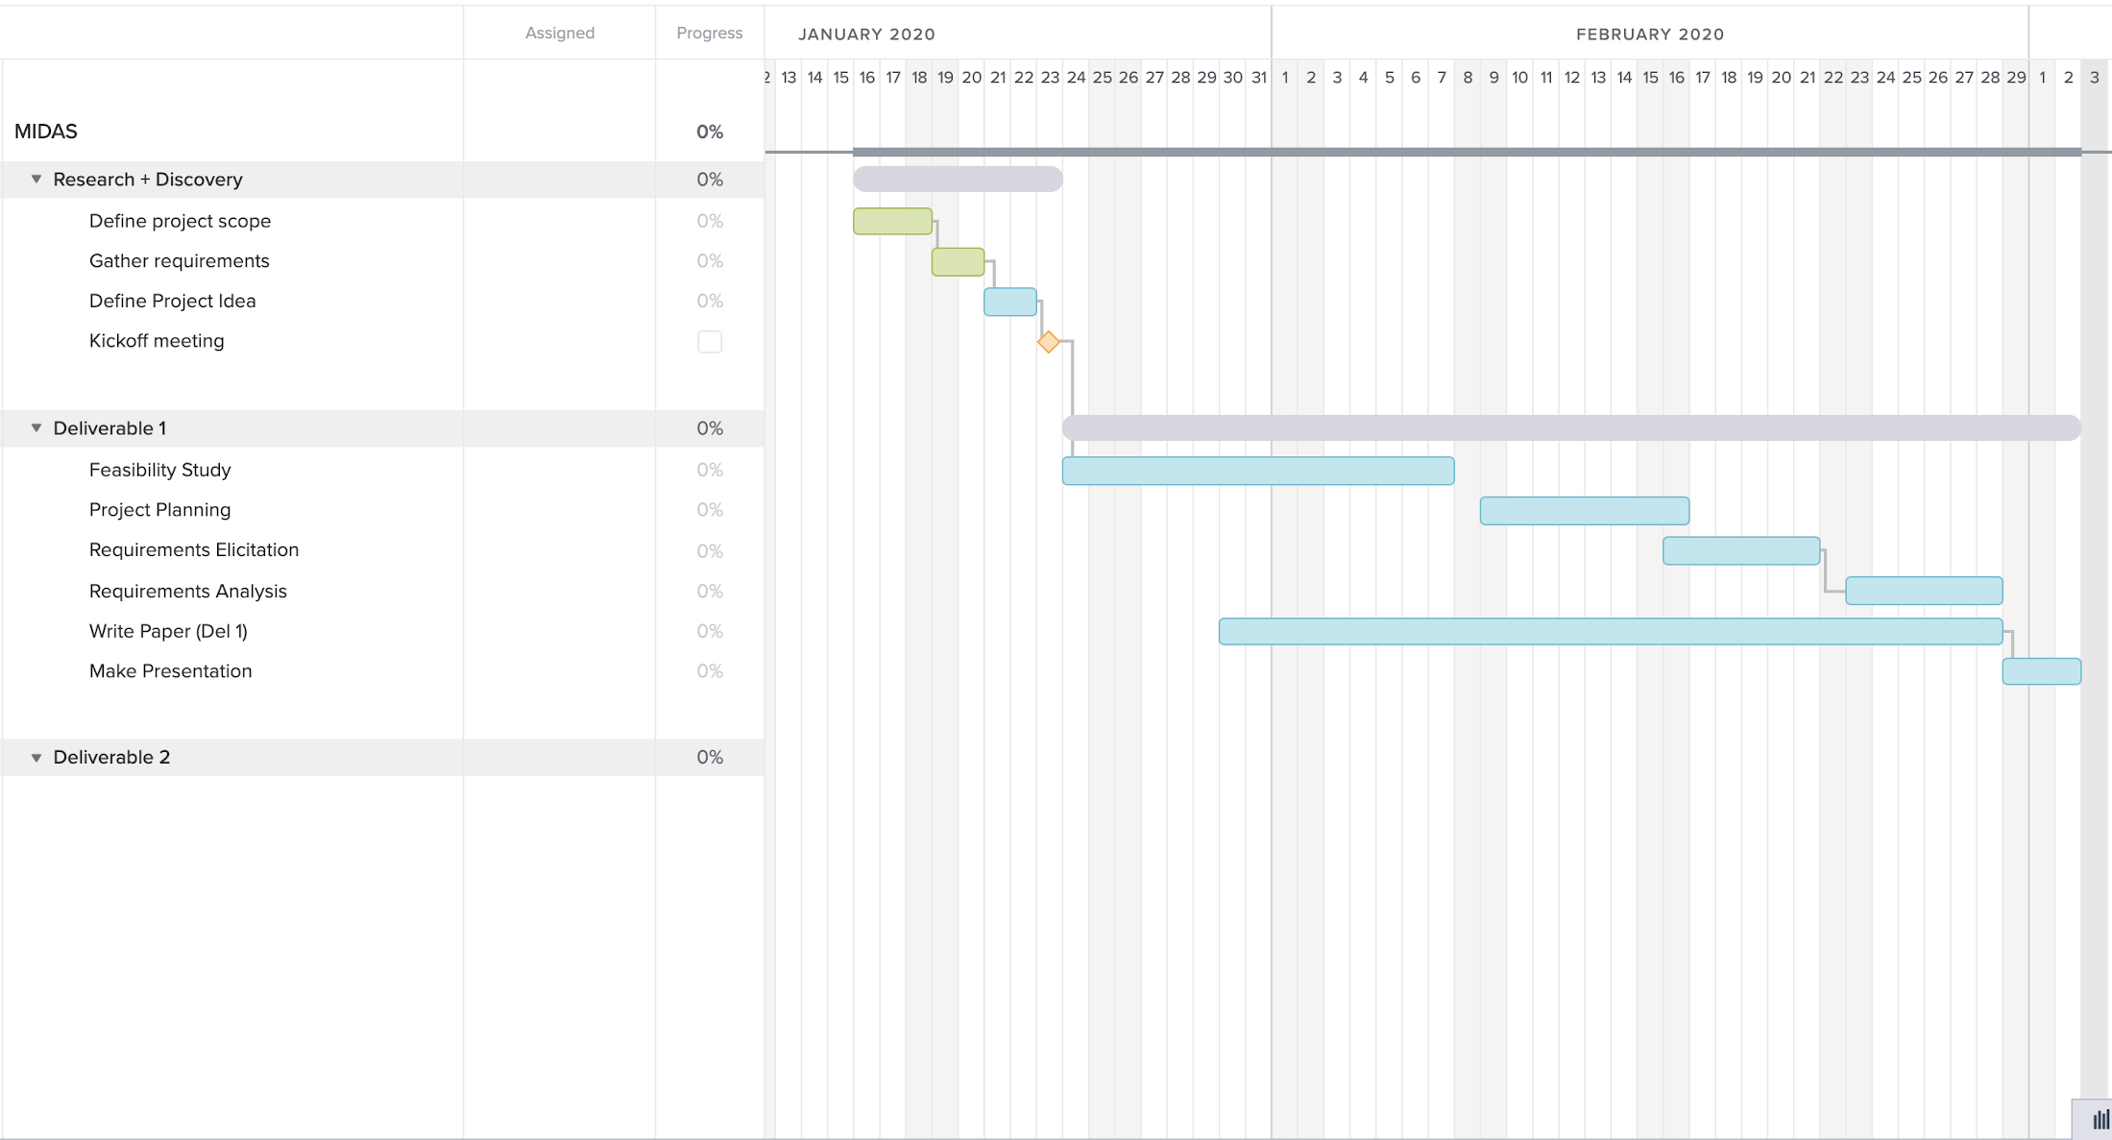
Project Plan

Slide 8
MIDAS-7-Web-Timeout
Pre-Condition:
The user has an account and is logged in.
Trigger:
The user has been inactive for 10 minutes.
Related Use Cases:
MIDAS-14-Web-Login
MIDAS-15-Web-Logout.
Decision Support:
Frequency: For 10,000 users, timeout is expected to occur 1500 times per hour.
Criticality: Medium Criticality. Even though this use case does provide some security for the user, it is not utterly necessary for the functionality of the app.
Risk: Low Risk. This use case is simple to implement, just forcefully log out the user after some time of inactivity.

Slide 9
MIDAS-7-Web-Timeout
Constraints:
Usability: The countdown dialog box should be simple and straightforward, so the user knows what to do.
Reliability: This use case is allowed to fail 1 in 7500 times.
Performance: The user should be logged out within 2 seconds of the countdown running off.
Supportability: Timeout will be supported in Mozilla Firefox and Chrome. The mobile application will be supported in Android and IOS.
Implementation: Implemented using React and will be available on browsers and in the mobile application.

Slide 10
MIDAS-4-Web-Add Stock
Pre-Condition:
User is logged in.
User is in the Dashboard.
Trigger: User clicks on the Add Stock Button
MIDAS displays the Add Stock Page.
User inputs the stock name and the amount.
User clicks the Submit button
MIDAS will store the newly made stock entity.
Related Use Cases:
MIDAS-3-Web-View User Stocks
Decision Support:
Frequency: Medium - performed every time a user decides to add a new stock.
Criticality: High - a fundamental part of MIDAS.
Risk: Medium - requires managing data.

Slide 11
MIDAS-4-Web-Add Stock
Constraints:
Usability: No previous training should be needed, process should take no more than 20 seconds to be completed.
Reliability: Mean Time to Failure - 3 failures for every 48 hours of operation is acceptable
Performance:
Stock data should be added to the database within a second.
Add Stock page should be displayed within a second
Supportability: should be displayed properly in Mozilla Firefox and Google Chrome.
Implementation: Use case will be implemented using React.

Slide 12
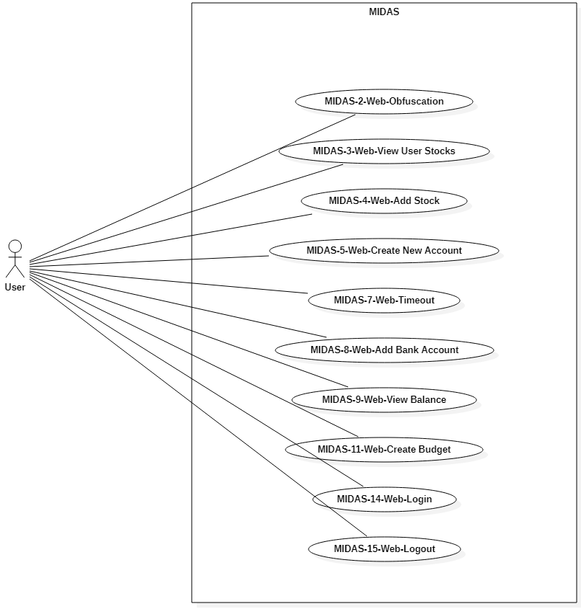
Use case diagram for web use cases that are being implemented

Slide 13
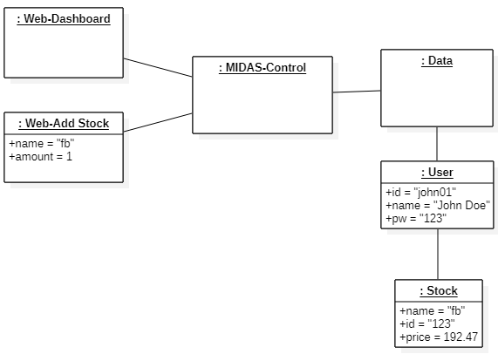
MIDAS-4-Web-Add Stock Object Diagram

Slide 14
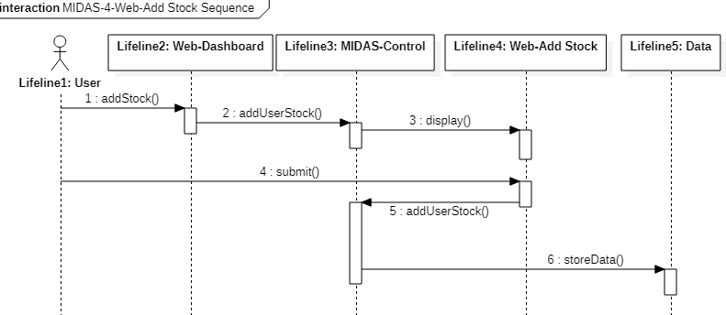
MIDAS-4-Web-Add Stock Sequence Diagram

Slide 15
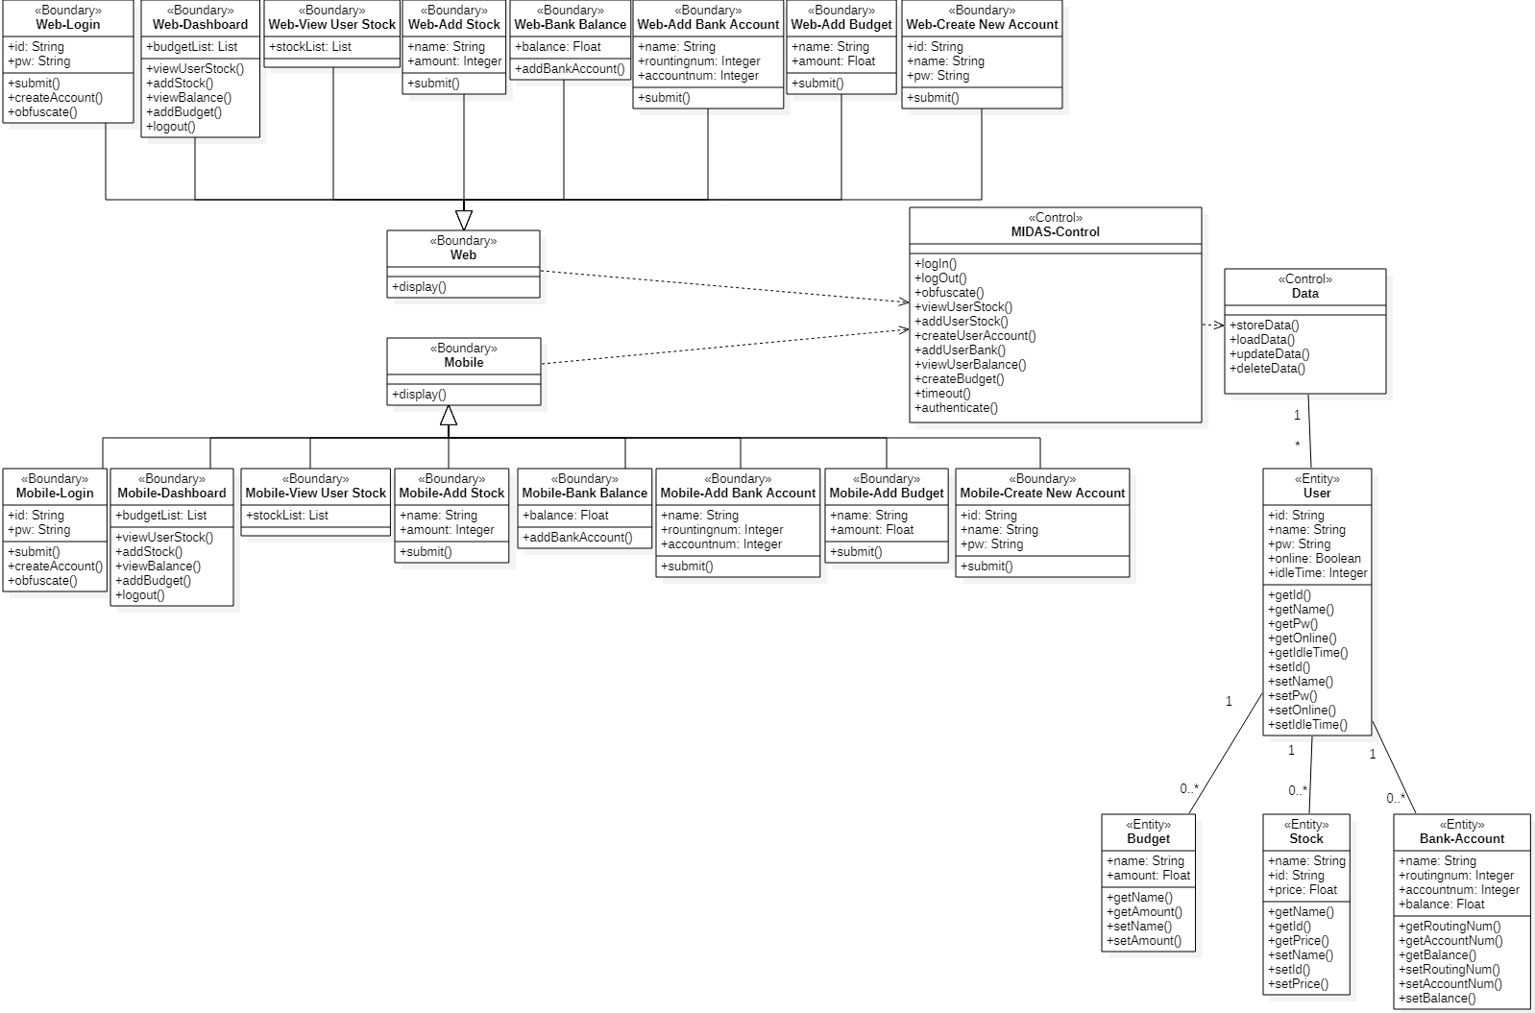
MIDAS Class Diagram

